Slide 1


Modeling acid rain pH variations in India Progress Presentation Environmental Reaction Modelling (CE-520)
Course Instructor – Dr. Harshad Vijay Kulkarni
Presented by – Anand Prabhakar
Roll no.- DD23017
School – SCENE
Institute – IIT Mandi
Presentation date– 8th May, 2024

Slide 2

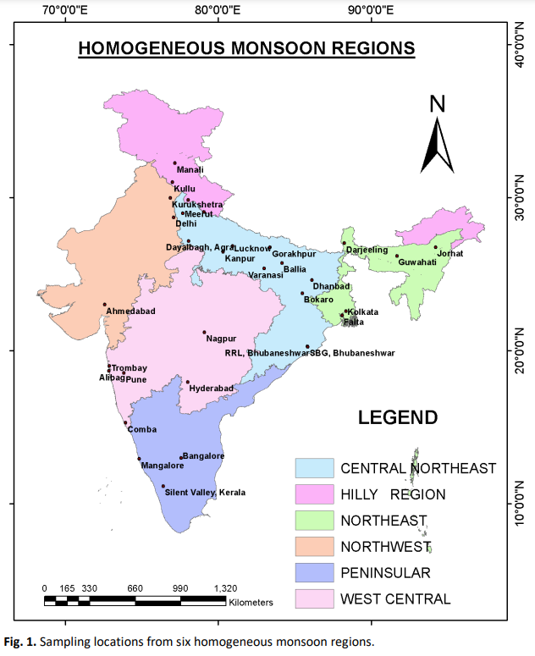
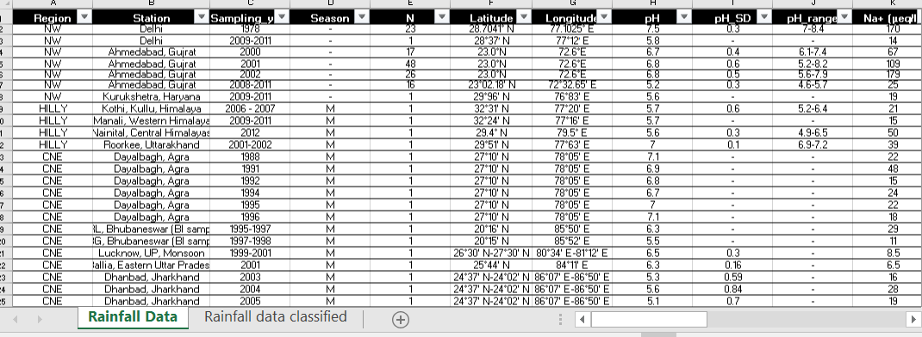
Acid rain : data sources
India – Region-wise data of wet deposition
Data for various region (in ueq./L except pH); 58 x 27
Region wise, countrywide and statewide data available from literature, datasets and texts.
Can be adopted to be used in the model by converting the data in units available in model.
Problem statement : to model the reaction based on the species data and predict the pH and compare to actual pH available in data.
(Majumdar et al., 2022)

Slide 3
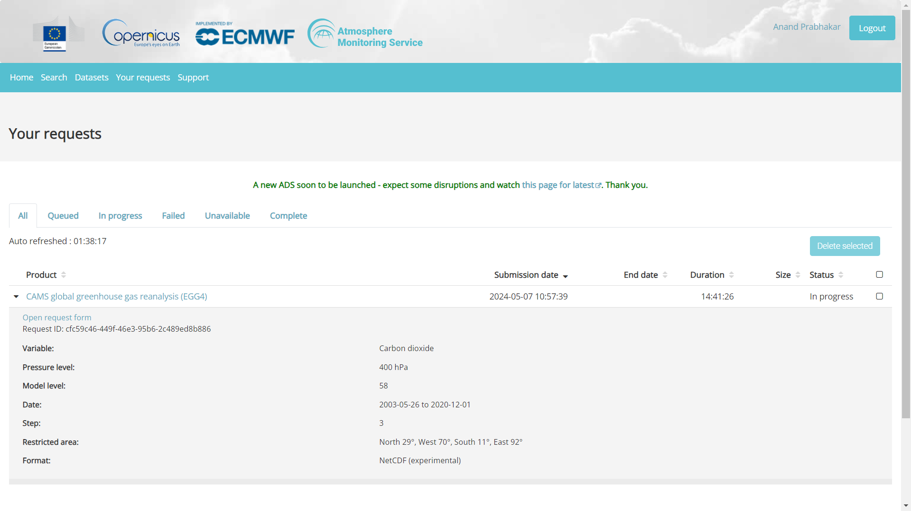
Additional data sources used..
Using CAMS portal to download the CO2 concentration data (gridded).
Planning to use the data for CO2 partial pressure data across Indian regions as categorized in the paper.
Data yet to download. Request has been put up.
If not available within time , I plan to use the SO2 partial pressure along with the meteoric condition.
(Copernicus atmospheric monitoring services, CAMS)

Slide 4
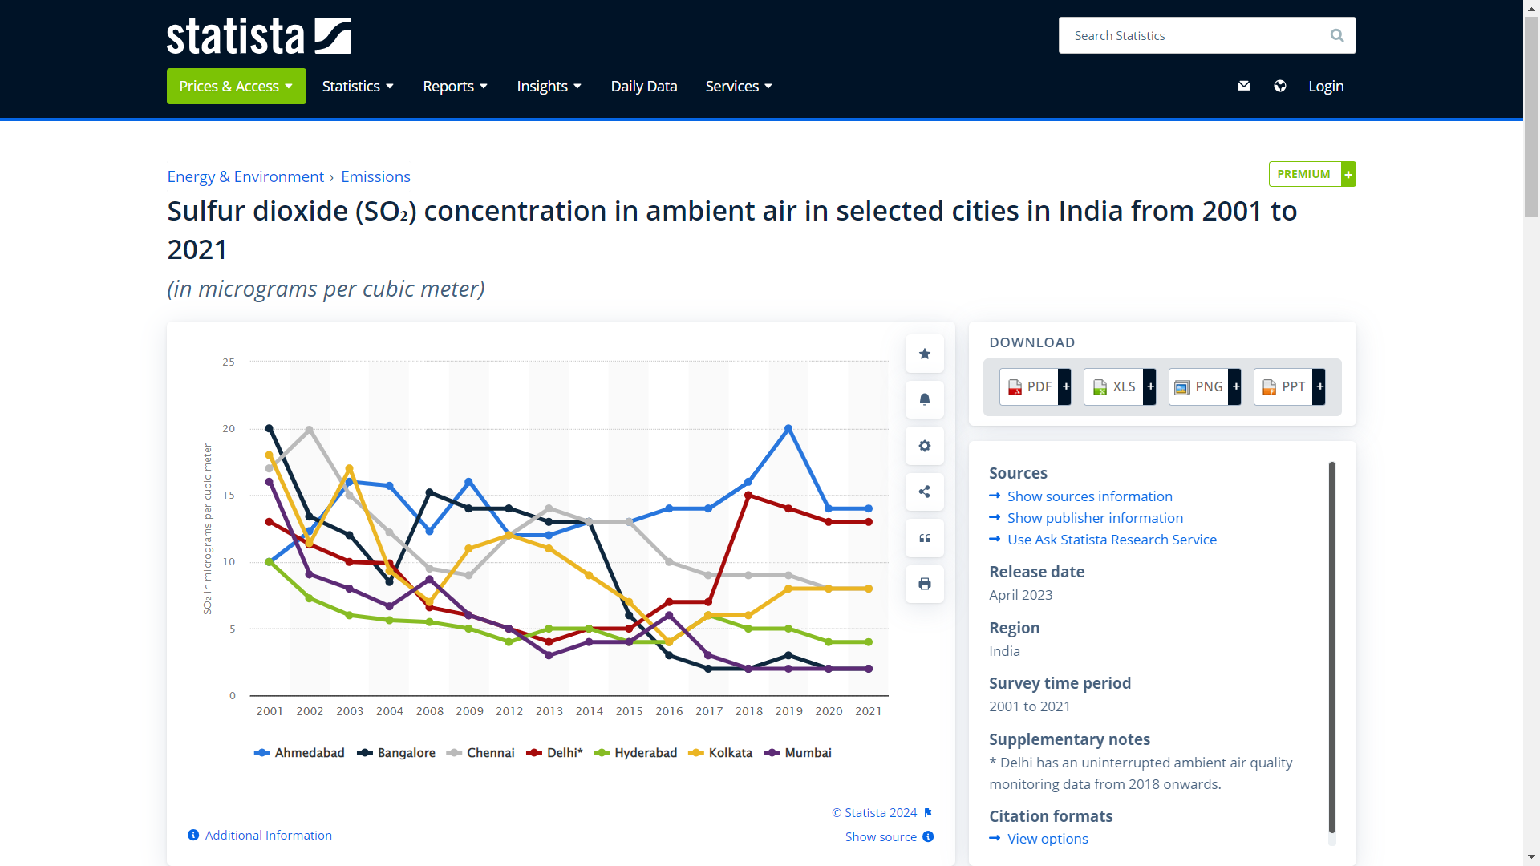
Additional data sources used..
Using Statista plot to get data of SO2 concentration in ambient air.
Its paid data (even after registration), so taking data point manually from the plot rather than purchasing.
Planning to use the data for SO2 partial pressure data across Indian regions as categorized in the paper.
(Copernicus atmospheric monitoring services, CAMS)

Slide 5
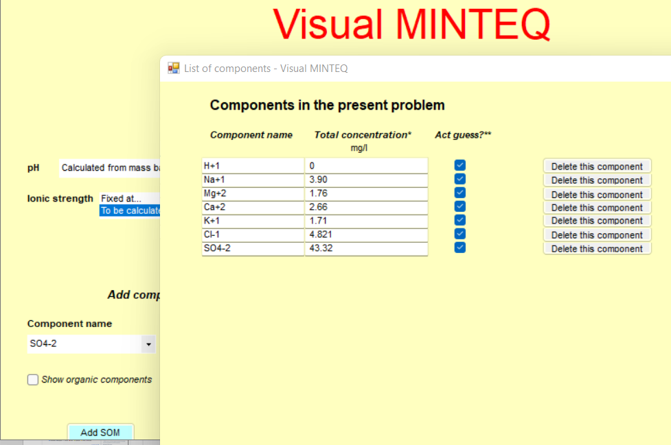
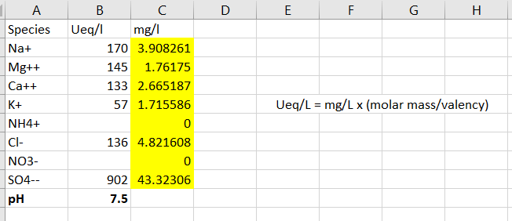
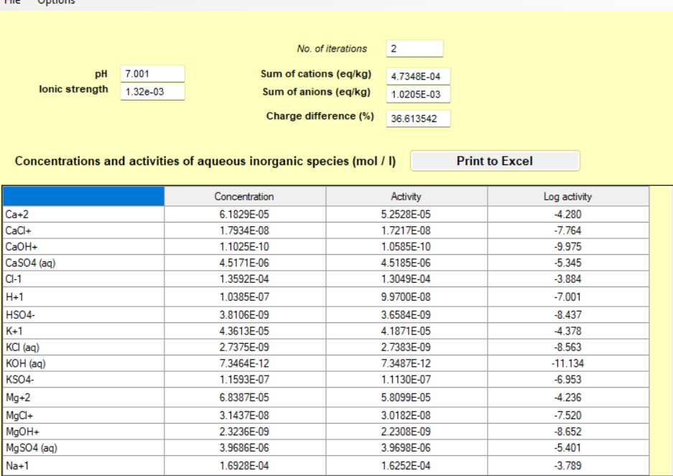
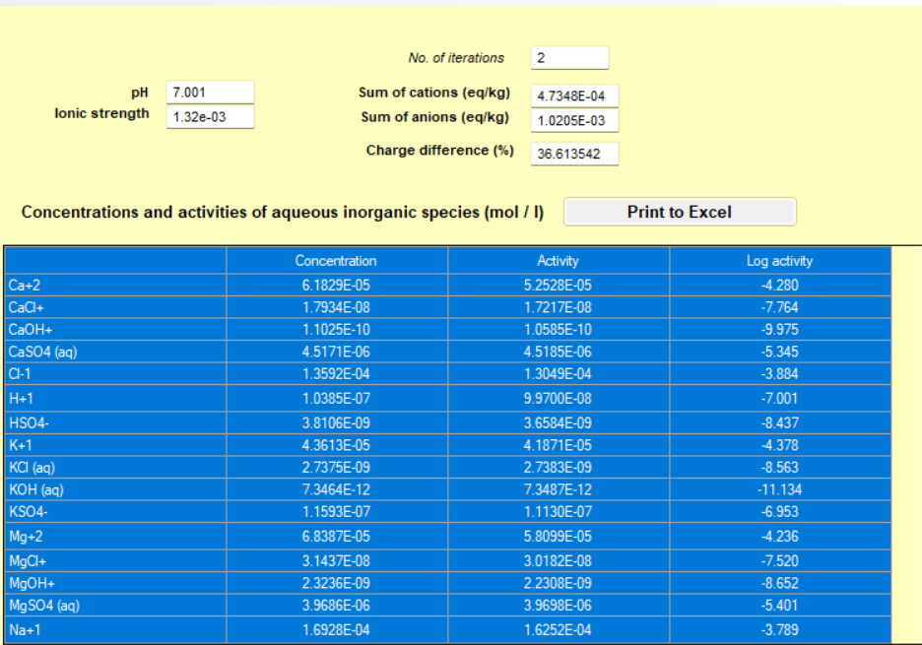
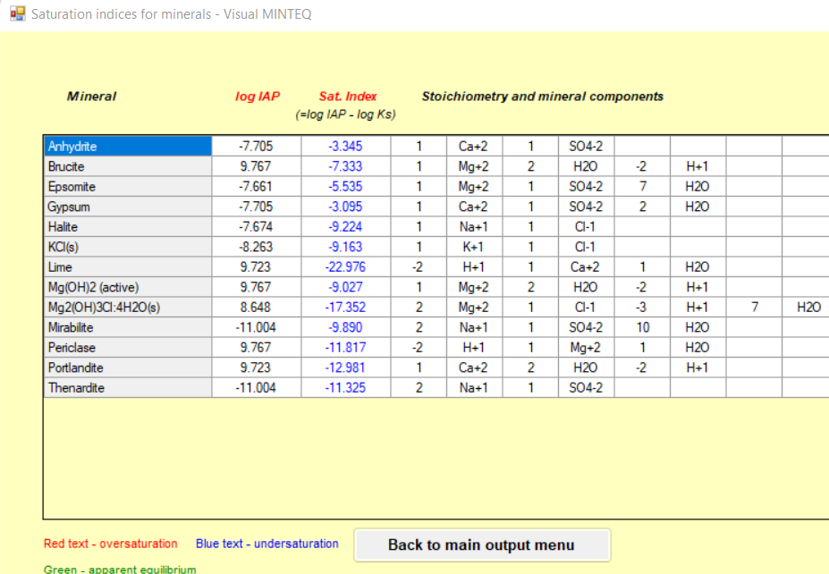
pH calculation using VMINTEQ
We have conc. In ueq./L which I converted in mg/L to input into the model
Species are added in the table under ambient, meteoric and under polluted condition.
Plotting the speciation diagram using swap option at varying pH.
Partial pressure data to be used in this model for creating polluted environment like condition.
Unit conversion of data
Species addition
pH calculation by model under ambient, meteoric and polluted environment is noted and is verified against actual pH in the data
(VMINTEQ)
Mineral precipitation data
Species at this pH;

Slide 6
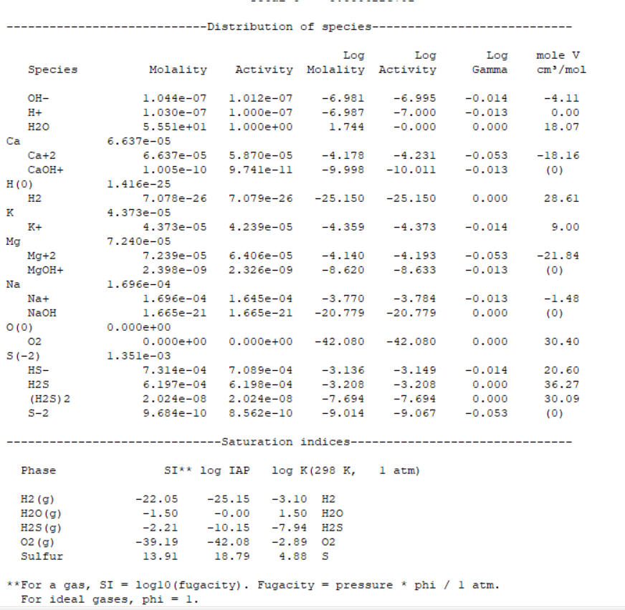
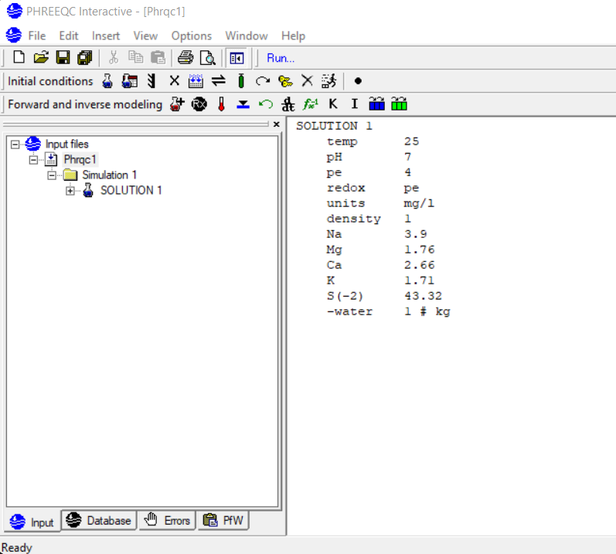
pH calculation using Phreeq-C
pH is noted from running the Phreeq-C model.
Species data to be generated for each 58 sample data.
Unit conversion of data
Data of Minerals and aq. species so generated (to be plotted in the speciation diagram of VMINTEQ). Also, pH is obtained after running model
(Phreeq-C)
Data input in mg/L under ambient cond.

Slide 7
pH calculation using GWB
We have conc. In ueq./L which I converted in mg/L to input into the model
Species are added in the table under ambient, meteoric and under polluted condition.
Plotting the speciation diagram using swap option at varying pH.
Unit conversion of data
Species addition
pH calculation by model under ambient, meteoric and polluted environment is noted and is verified against actual pH in the data
(VMINTEQ)
Mineral precipitation data
Species at this pH;

Slide 8
pH comparison
Planning to use Geochemist’s Workbench.
The pH obtained from both the models are compared in all conditions.
In polluted conditions the pH so obtained from model is compared with that observed in field (i.e. from the data).

